Slide 1
Text mining
Fani Apostolidou Kiouti

Slide 2
Text mining
Text mining aims in gathering information from a different type of input data: free text data without any structure of tabular fashion.
Vectorize the input
Investigate common patterns among the new input data
Information extraction
Information retrieval
Natural Language Processing (NLP)
Clustering
Document classification

Slide 3
Text mining
Applications
speech-to-text conversion
optical character recognition
word segmentation or tokenization, lemmatization and stemming
sentence breaking
terminology extraction
relationship semantics
topic recognition
argument recognition
text summarization
natural language generation and question answering

Slide 4
Text mining
Our goals here will be limited to text tokenization and distributional semantics with semantic parsing:
Break up the text into tabular data we can analyze
Find and graphically represent word relationships in the corpus
Corpus: an unstructured collection of texts, irrespective of language.
Token: a building block of a natural language; a word or a phrase or a whole sentence.
Tabulation: counting the occurrences of an instance systematically

Slide 5
Raw
Δεν προσκομίσθηκε προηγούμενη μαστογραφία –και γενικά προηγούμενες εξετάσεις
Ιστορικό όγκεκτομής στο άνω τεταρτημόριο του δεξιού μαστού με εικόνα διαταραχής της αρχιτεκτονικής μετεγχειρητικής- μετακτινικής πρωτίστως αιτιολογίας
Γενικευμένη πάχυνση του δέρματος σύστοιχα και οιδηματώδη απεικόνιση του υποδορίου λίπους.
Η διαταραχή της αρχιτεκτονικής που απεικονίζεται στην προαναφερθείσα θέση αναδεικνύει στο εμβαδόν της ανομοιογενούς υφής σχηματισμούς με κυστικά εσωτερικά στοιχεία. Το ως άνω πιθανά αποδίδεται σε μετεγχειρητικής αιτιολογίας αλλοίωση.
Δεν παρατηρείται υγρική συλλογή στην περιοχή της επέμβασης
Σύμπλεγμα διατεταμένων πόρων του τύπου της ΤΠΛΜ διαστάσεων 9χ10χ11mm απεικονίζεται στον άξονα της 9η ώρας δεξιά.
Λιπώδεις κατά βάσει αρ μαστός με τα ελάχιστα εναπομείναντα ινοαδενικά στοιχεία να κατανέμονται ομοιογενώς.
ACR- Α (όσον αφορά την σύσταση και την πυκνότητα του μαστού).
BIRADS- 0 Συνιστάται συγκριτικός έλεγχος με βάσει το ιστορικό της εξεταζόμενης

Slide 6
Tabulated
[1] "Δεν προσκομίσθηκε προηγούμενη μαστογραφία –και γενικά προηγούμενες εξετάσεις "
[2] ""
[3] "Ιστορικό όγκεκτομής στο άνω τεταρτημόριο του δεξιού μαστού με εικόνα διαταραχής της αρχιτεκτονικής μετεγχειρητικής- μετακτινικής πρωτίστως αιτιολογίας "
[4] ""
[5] "Γενικευμένη πάχυνση του δέρματος σύστοιχα και οιδηματώδη απεικόνιση του υποδορίου λίπους."
[6] "Η διαταραχή της αρχιτεκτονικής που απεικονίζεται στην προαναφερθείσα θέση αναδεικνύει στο εμβαδόν της ανομοιογενούς υφής σχηματισμούς με κυστικά εσωτερικά στοιχεία. Το ως άνω πιθανά αποδίδεται σε μετεγχειρητικής αιτιολογίας αλλοίωση. "
[7] "Δεν παρατηρείται υγρική συλλογή στην περιοχή της επέμβασης"
[8] ""
[9] "Σύμπλεγμα διατεταμένων πόρων του τύπου της ΤΠΛΜ διαστάσεων 9χ10χ11mm απεικονίζεται στον άξονα της 9η ώρας δεξιά."
[10] ""
[11] "Λιπώδεις κατά βάσει αρ μαστός με τα ελάχιστα εναπομείναντα ινοαδενικά στοιχεία να κατανέμονται ομοιογενώς."
[12] ""
[13] "ACR- Α (όσον αφορά την σύσταση και την πυκνότητα του μαστού)."
[14] "BIRADS- 0 Συνιστάται συγκριτικός έλεγχος με βάσει το ιστορικό της εξεταζόμενης "
>

Slide 7
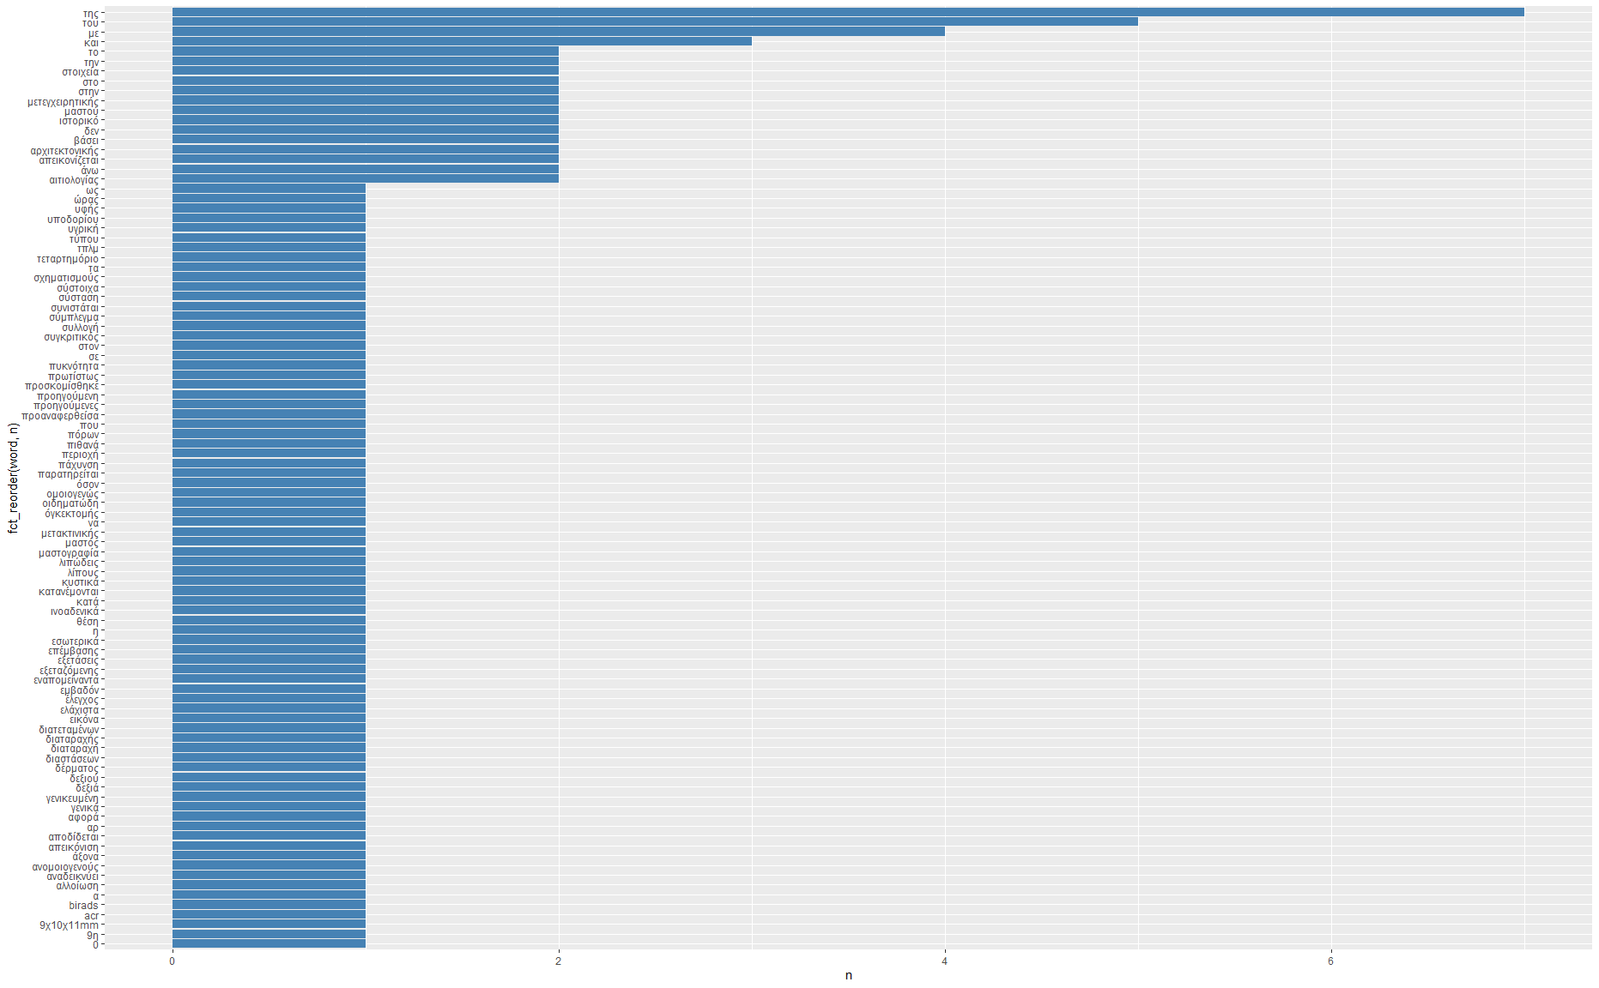
Tokenized

Slide 8
free text
 | attr | attr | attr | …
token
token
token
token
tf
idf
tf_idf
Zipf’s law
phi-coefficient
COUNTS

Slide 9
Clearing text up
Indices for character classes | used
[[:digit:]] | to isolate digits
[[:lower:]] | to choose lower-case letters
[[:alnum:]] | to choose alphanumeric characters
[[:space:]] | to choose spaces (also tabs, newlines, returns)
[[:punct:]] | to choose punctuation
The use of regular expressions to clear up a document is based on the use of characters and rules. Indexing and conditionals are heavily used and the main functions are grep*() and str_*().
Pattern detection and location is the process during which a document is scanned for a predefined set of characters (a pattern) and its metadata (ie first encounter, number of repetitions, position, length).
Trailing space: a redundant white space between words or at the end of sentences.

Slide 10
All words are not equal
It is evident that some words appear more often than others; we could exclude them in various ways:
Use word length to exclude them; but most of them are 3-letter words and such an approach will cost us an important negation word: “δεν”.
Use regular expressions that fit the words we need to exclude.
Use a list of words and then exclude them from the text.
Stop word: a commonly used word that serves syntax and grammatical purposes rather than carry meanings
Stemming: removing suffixes
Lemmatization: isolating the lemma; the standard form of the word with no suffix.

Slide 11
Quantifying counts
How can we understand the topic of the texts in either case? A suggestion would be to measure the weight of the words (or tokens) that make up the text.
Term frequency: how often is a word used in the corpus?
Of course there are words that are repeated very often to make up meaningful natural language sentences; the stop words we encountered in the single text analysis.
Zipf’s law states that the frequency of any word in the corpus is inversely proportional to its rank in the frequency table
Inverse document frequency: the natural logarithm of the fraction of the total number of documents to the number of documents containing the word

Slide 12
Quantifying counts
The inverse document frequency decreases the weight for commonly used words. The multiplication of term frequency and inverse document frequency is the statistic tf-idf and it is used to estimate the gravity of a word to a text in a corpus of texts.
The higher the statistic the more relevant the word, or any token, for the corpus.
In practice, you could use the approach to identify the theme of the text or to construct a dictionary to identify texts with a similar vocabulary.

Slide 13
Clustering terms
The clustering of terms gives some insights on how words are used within the text.
The cluster is mostly used for inspection and sharing; the information that can be used from an algorithm is contained in the first line of the graph which creates lists describing the relationships of the words.
However, the researcher can evaluate the use of the negation word “δεν” along with other words and the BIRADS and ACR classification.
For the latter, we can extract these information; in a similar way as before, and save them for analysis.

Slide 14
Contextual analysis – analysing more than one word
Meaning in natural languages is rarely held in a single word.
Phrases are important pieces of speech that carry information based on the combination of the words they are comprised of.
An example of this paradigm is negation: the syntax that reverses the meaning of the same words with the use of a negative word or affix.
The same tokenization process can be implemented to split the text into n-grams.
n-grams: a sequence of n words, as they appear in data

Slide 15
Contextual analysis
Any number of consecutive words may be applicable depending on the context and the individual linguistic characteristics of different scientific (or other) fields.
The following visualization is a Markov chain, a model in text processing in which every word is only dependent on the previous word.
Markov chain: a stochastic process that models a finite set of states, with fixed conditional probabilities of jumping from a given state to another

Slide 16
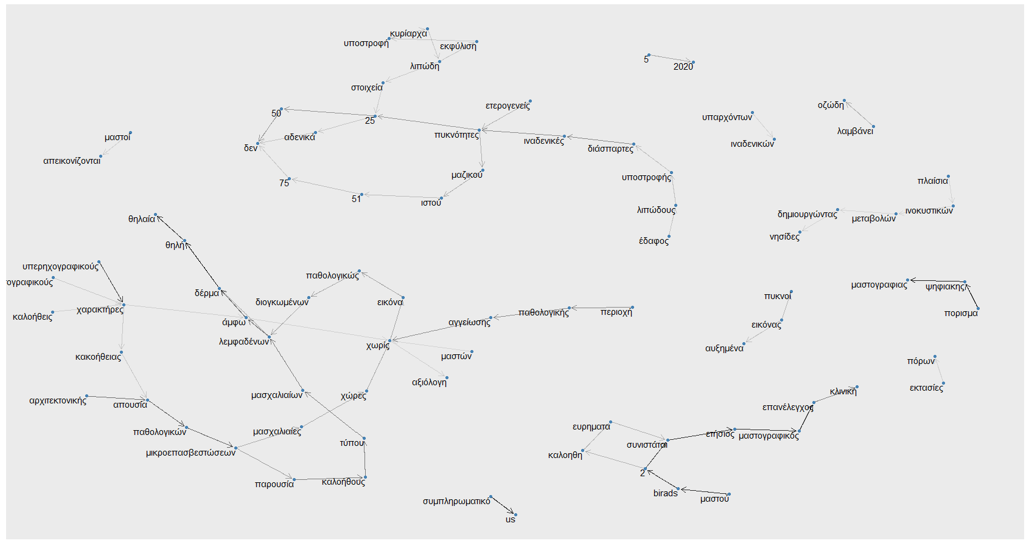

Slide 17
Markov chains
A Markov chain transitions from one defined state (the word in our case) to the other according to probabilistic rules.
In a Markov chain is does not matter how the process arrived at the state (the previous words have no weight), only where it starts from and the time elapsed.
A simple example is the one seeking the probability of choosing a certain colour of ball when blindly selecting from a bag of coloured balls with the property of replacing the ball every time one is drawn.
Depending on this model, we can extract information on how words are used in the corpus and perform tasks as text simulation.

Slide 18
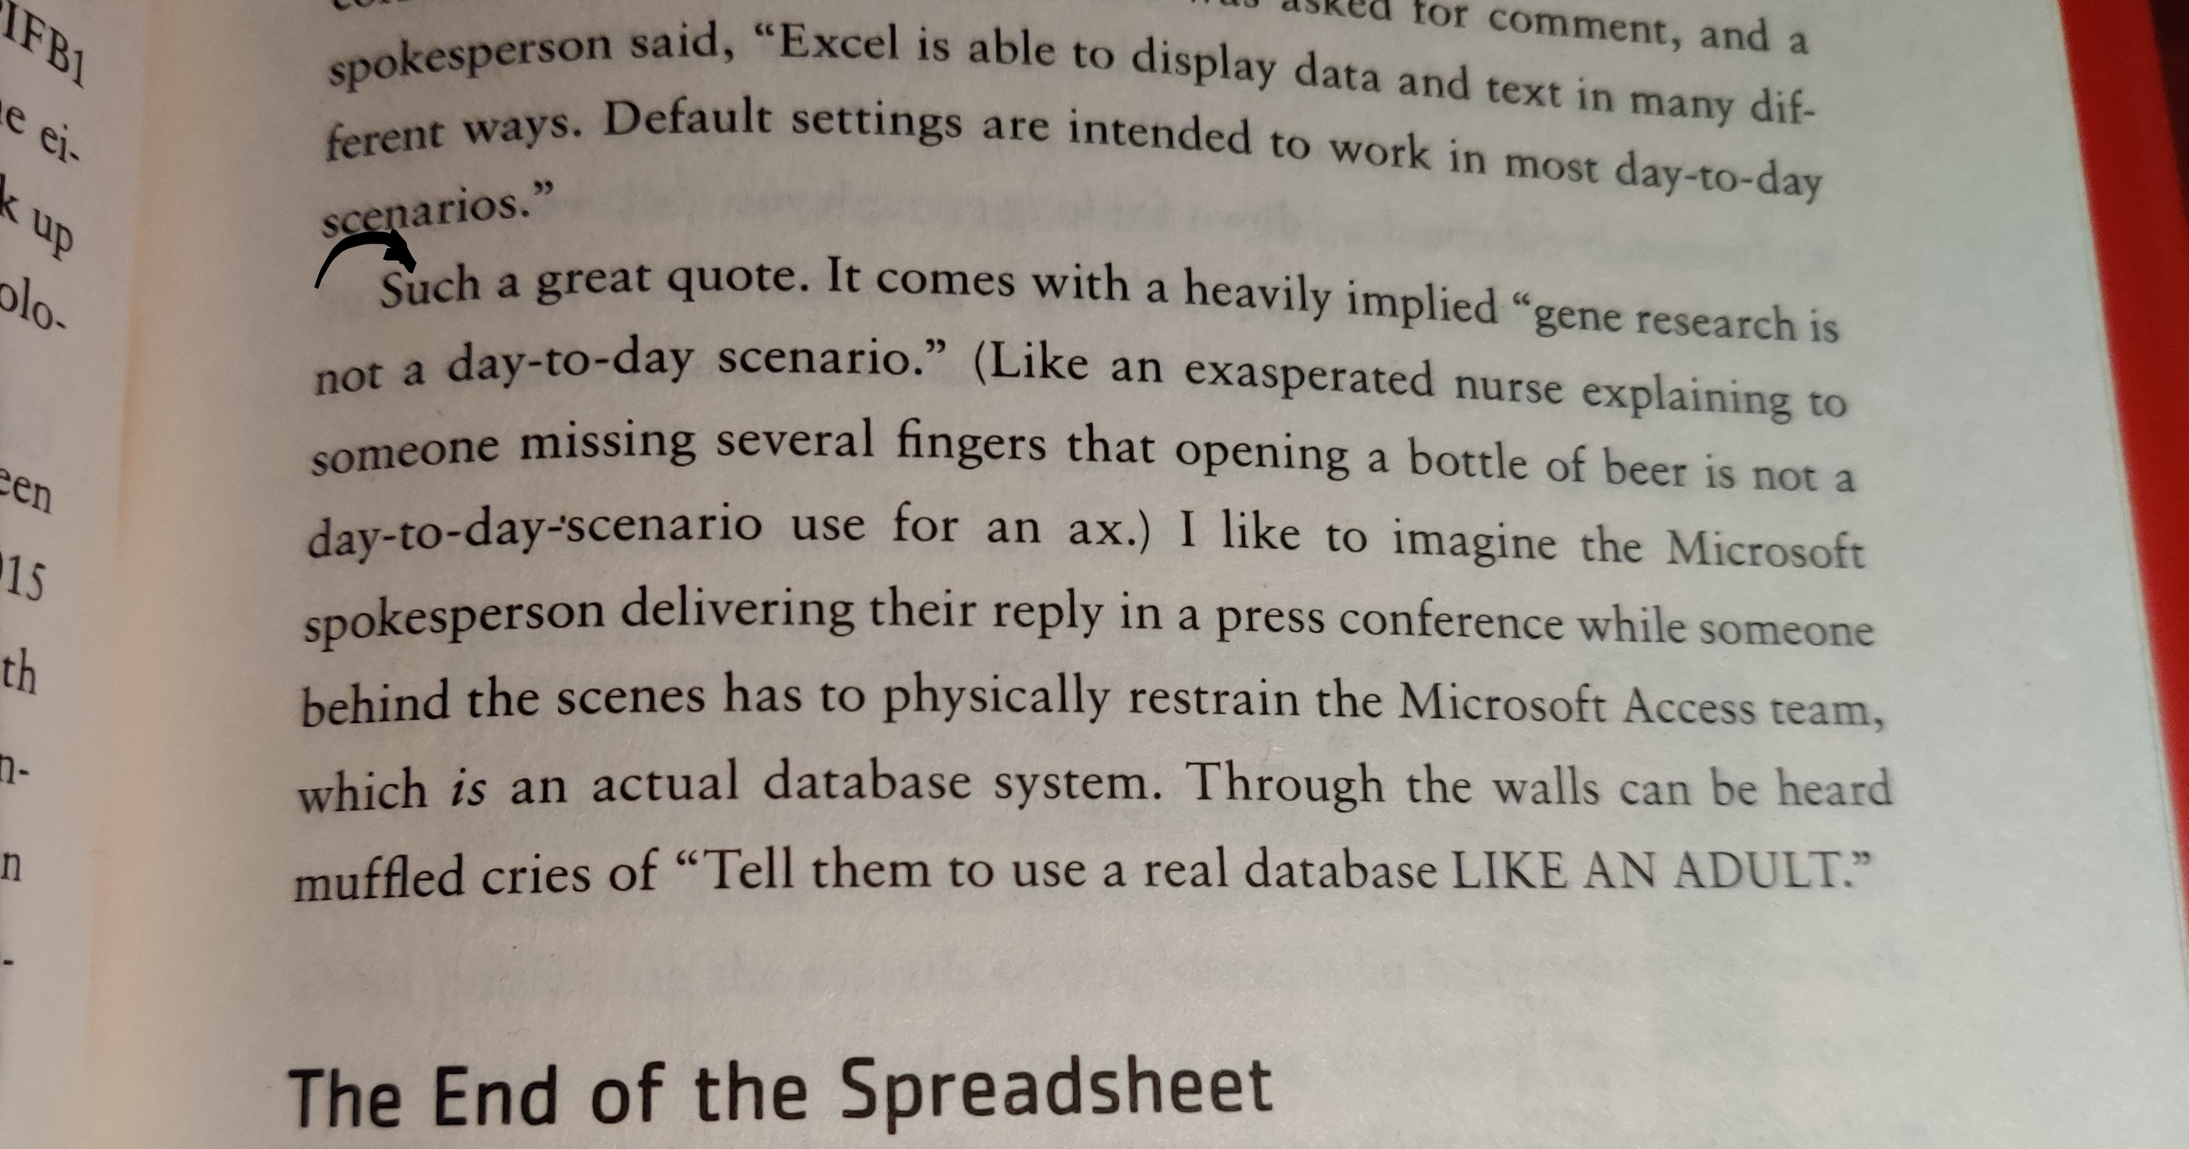
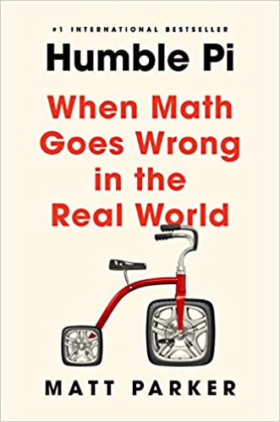

Slide 19
Correlations
Correlating n-grams provides the basis to explore words that tend to co-occur in text even when they do not occur next to each other.
Counting the occurrence of the entire matrix of word combinations found in the corpus allows calculation fo the correlations of terms – how often words appear together relatively to how often they appear separately. This metric is called a phi coefficient (binary correlation).
The correlations may help us investigate words with special interest and their most common associates.

